Slide 1


NS
LECTURE
Firewall Technologies
Network Security
Diploma in CSF
Year 3 (2021/22), Semester 5
2

Slide 2
Objectives
At the end of this, you will get to know more about firewalls:
Types of Firewalls
Firewall Deployment Options
Virtual Wire Interface
Layer 3 Interface
Security Zone
Interface Management Profile
DHCP
Virtual Router

Slide 3
Type of Firewalls
Packet Filter Firewall
Circuit Level Gateways
Application Level Gateways
Stateful Multilayer Firewall
Next-Generation Firewall

Slide 4
1. Packet Filter Firewall
The Packet Filtering Firewall is one of the most basic firewalls.
Each packet passing through is inspected and then the firewall decides to pass it or not.
The packet filtering can be divided into two parts:
Stateless packet filtering.
If the information about the passing packets is not remembered by the firewall, then this type of filtering is called stateless packet filtering.
The allow/deny decisions are taken on packet by packet basis and these are not related to the previous allowed/denied packets.
Stateful packet filtering.
If the firewall remembers the information about the previously passed packets, then that type of filtering is stateful packet filtering.
These can be termed as smart firewalls.

Slide 5
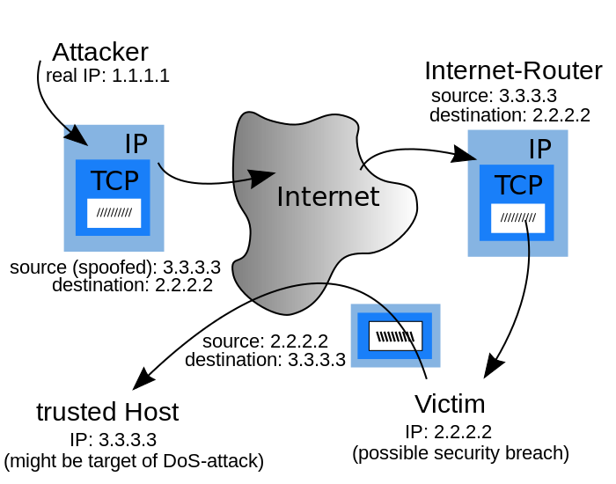
1. Packet Filter Firewall
Advantage:
The biggest advantage of Packet Filtering Firewalls is cost and lower resource usage and best suited for smaller networks.
Disadvantage:
Packet Filtering Firewalls can work only on the Network Layer and these Firewalls do not support complex rule based models. And it’s also vulnerable to Spoofing in some cases.

Slide 6
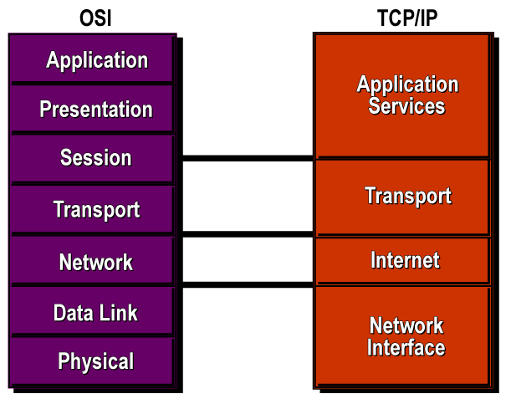
2. Circuit Level Gateways
Circuit level gateways:
work at the session layer and monitor TCP handshaking between packets to determine whether a requested session is legitimate

Slide 7
2. Circuit Level Gateways
Advantage:
Circuit level gateways are comparatively inexpensive
Disadvantage:
Circuit level Gateways do not filter Individual Packets. After Establishing a Connection, an Attacker may take advantage of this.

Slide 8
3. Application Level Gateways
Application level gateways
work on the Application layer of the OSI model and provide protection for a specific Application Layer Protocols.
Proxy server is the best example of Application Level Gateways Firewalls, it can prevent any direct connection between a trusted server or client and an untrusted host.
Application level gateway would work only for the protocols which are configured. For example, if we install a web proxy based Firewall than it will only allow HTTP Protocol Data.

Slide 9
4. Stateful Multilayer Firewall
Stateful multilayer inspection firewalls
work at the application , session, network layer.
They filter packets at the network layer, determine whether session packets are legitimate and evaluate contents of packets at the application layer
They allow direct connection between client and host, alleviating the problem caused by the lack of transparency of application level gateways.

Slide 10
5. Next Generation Firewall
NGFWs act as a platform for network security policy enforcement and network traffic inspection.
Standard capabilities of the first-generation firewall: This includes packet filtering, stateful protocol inspection, network-address translation (NAT), VPN connectivity, etc.
Truly integrated intrusion prevention: this includes support for both vulnerability-facing and threat-facing signatures, and suggesting rules (or taking action) based on IPS activity. The sum of these two functions collaborating via the NGFW is greater than the individual parts.

Slide 11
5. Next Generation Firewall
Full stack visibility and application identification: ability to enforce policy at the application layer independently from port and protocol.
Extra-firewall intelligence: ability to take information from external sources and make improved decisions. Examples include creating blacklists or whitelists and being able to map traffic to users and groups using active directory.
Adaptability to the modern threat landscape: support upgrade paths for integration of new information feeds and new techniques to address future threats.
In-line support with minimum performance degradation or disruption to network operations.

Slide 12













Palo Alto NGFW Hardware Platforms
PA-200
VM- Series
(Virtual Machines)
PA-500
PA-3000 Series
PA-5000 Series
PA-4000 Series
PA-2000 Series

Slide 13
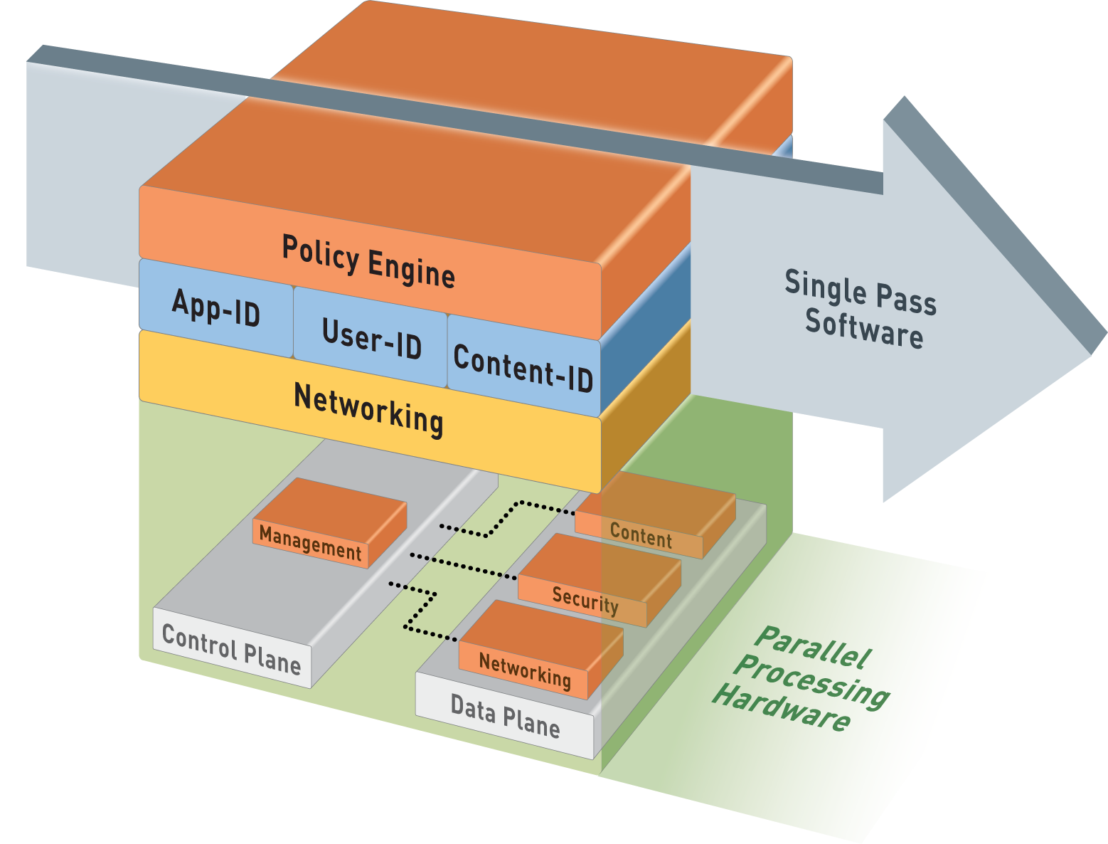
Palo Alto Networks Single-Pass Architecture
Single pass:
Operations per packet:
Traffic classification with App-ID technology
User/group mapping
Content scanning – threats, URLs, confidential data
One single policy (per type)
Parallel processing:
Function-specific parallel processing hardware engines
Separate data/control planes

Slide 14
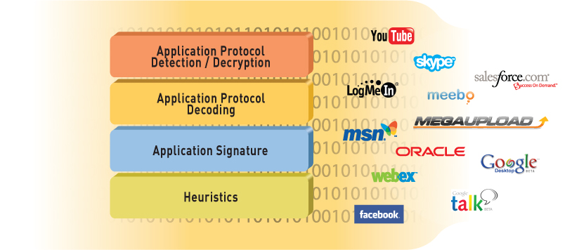
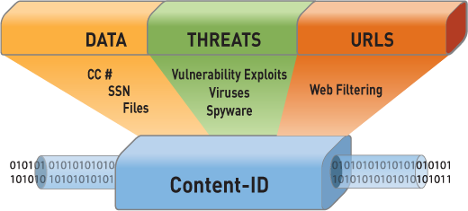
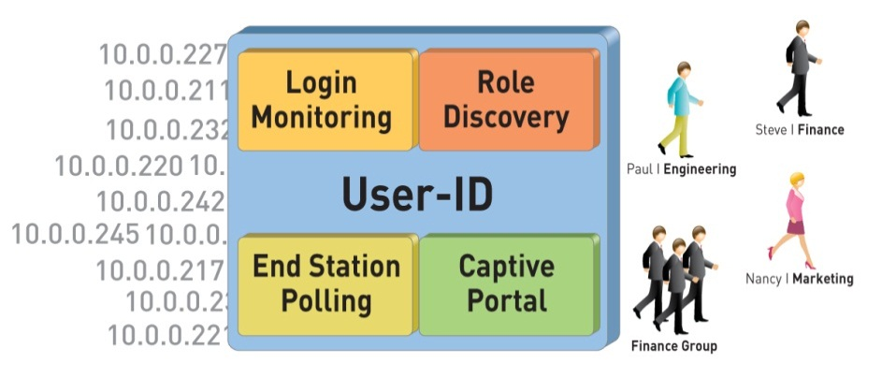
Single Pass Architecture Engines
App-ID™
Identify the application
Content-ID™
Scan the content
User-ID™
Identify the user

Slide 15









Deployment Options
Virtual Wire Mode
Virtual Wire Mode: Using virtual wire interfaces the firewall can be inserted into an existing topology without requiring any reallocation of network addresses or redesign on the network topology.
In this mode, all of the protection and decryption features of the device can be used.
NAT functionality is provided in this mode.
Application ID, Content ID, User ID, SSL Decryption
Includes NAT capability

Slide 16
Deployment Options
Layer 3 Mode
Layer 3 Mode: Using Layer 3 interfaces the firewall can take the place of any current enterprise firewall deployment.
All of the Virtual Wire Mode capabilities with the addition of Layer 3 services: Virtual Routers, VPN and, Routing Protocols

Slide 17
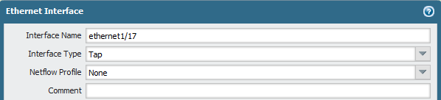
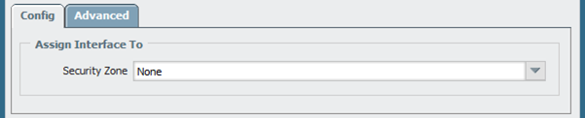
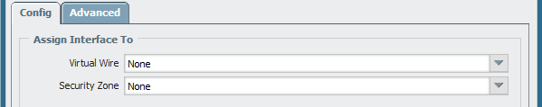
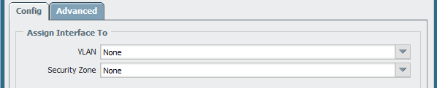
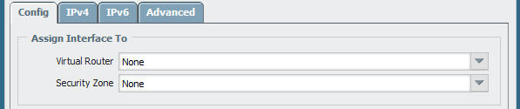
Ethernet Interface Configuration
Network > Interfaces > Ethernet
Interface Type:
Tap
Virtual Wire
Layer 2
Layer 3
Virtual Wire
Layer 2
Layer 3

Slide 18
Virtual Wire Interface
Binds TWO firewall interfaces together through Virtual Wire object
Typically used when no switching or routing is needed
No configuration changes for adjacent network devices
Possible to insert the firewall into an existing topology without requiring any reallocation of network addresses or redesign on the network topology.
Zone A
(Virtual Wire)
Firewall
Zone B
(Virtual Wire)
Virtual Wire object
Virtual Wire interface
Virtual Wire interface
No IP or MAC
No IP or MAC
Traffic inspection and control

Slide 19


Virtual Wire Interface
Network traffic flows through a firewall in a virtual wire, which means that the firewall can examine traffic and block traffic.
E1/2
E1/1
Internet
LAN
(User Network)

Slide 20
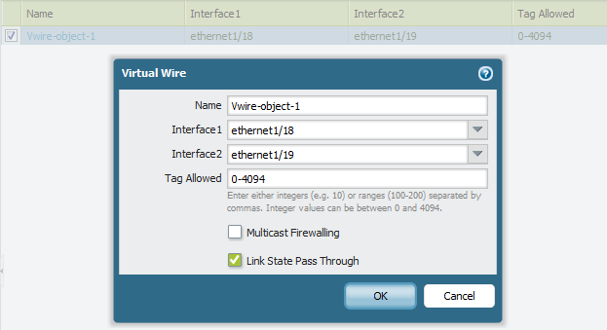
Configuring a Virtual Wire Object
Network > Virtual Wires > Add
Interfaces in the virtual wire

Slide 21
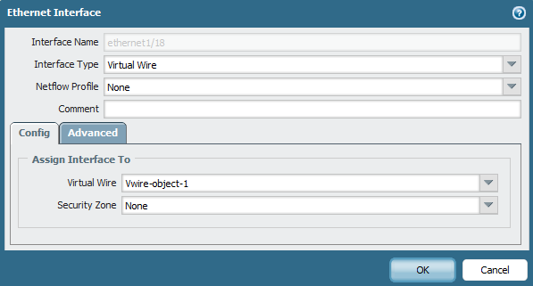
Configuring Virtual Wire Interfaces
Network > Interfaces > Ethernet
Interface Type
Virtual Wire Object
Security Zone
Notes:
If the virtual wire object has not been configured, the Virtual Wire field can be left blank. The interface names can be specified when the virtual wire object is created.
Since traffic will flow between virtual wire interfaces, a zone is required. Only zones that match the Interface type will be presented by the pull-down in the interface.

Slide 22
Layer 3 Interfaces
Enables routing between multiple interfaces:
Requires a virtual router
Requires network configuration to accommodate new IP addresses
Routing between Layer 3 interfaces requires a router. An internal virtual router provides a routable connection between the Layer 3 interfaces.
Zone A
(Layer 3)
Firewall
Zone B
(Layer 3)
Layer 3 interface
Layer 3 interface
Virtual Router
IP address
IP address
Traffic inspection and control

Slide 23
Layer 3 Interfaces
Network traffic can flow through a firewall between Layer 3 interfaces, which means that the firewall can examine traffic and block traffic.
Layer 3
E1/3
10.1.2.1/24
E1/4
Internet
Users
E1/5
172.16.2.1/24
192.168.2.1/24
Routing between networks
DMZ

Slide 24
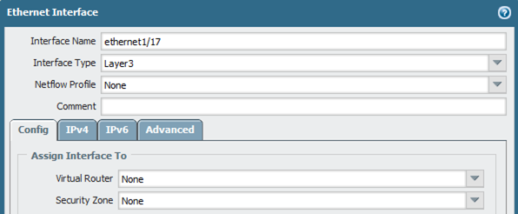
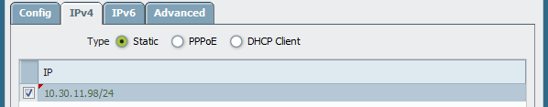
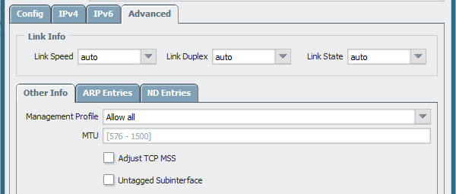
Configuring a Layer 3 Interface
Network > Interfaces > Ethernet
Interface Type: Layer 3
Virtual Router
Minimum
Requirement
Security Zone
IP Address
Click Network > Network Profiles > Interface Mgmt to define a interface management profile

Slide 25
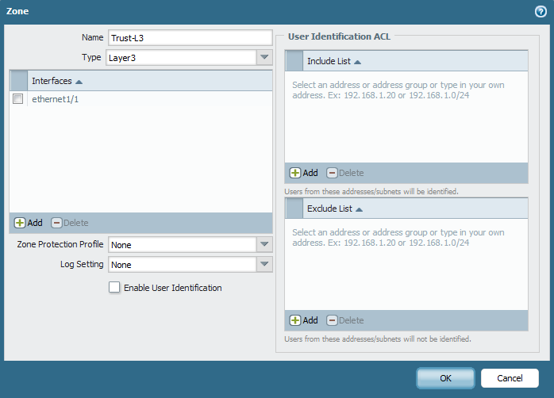
Configuring Security Zones
Network > Zones
Zone Types:
Tap
Virtual Wire
Layer 2
Layer 3
* multi-virtual system capable firewalls only
Notes:
Security zones are defined by type. The available types are:
Tap
Virtual Wire
Layer 2
Layer 3

Slide 26
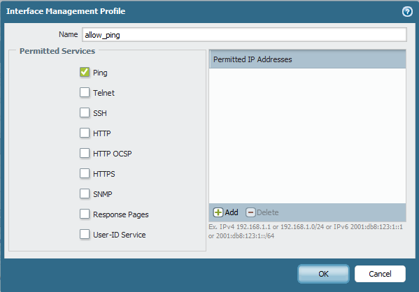
Interface Management Profile
Network > Network Profiles > Interface Mgmt > Add
Defines which management functions are allowed on a traffic interface
Management Profiles are applied to Layer 3 Interface(s)
Restricts administrative access to specific IP addresses
Notes:
By default, any management traffic sent to or from the firewall goes through the out-of-band management interface (MGT). Alternatively, a Layer 3 interface can be used to source this traffic and also receive inbound management traffic.
Management features enabled by the profile can be restricted to specific IP address with the Permitted IP Addresses panel. If configured, only the IP addresses listed can use the services selected when defining the profile. If the field is left blank, the profile allows any IP address to used the configured services.

Slide 27
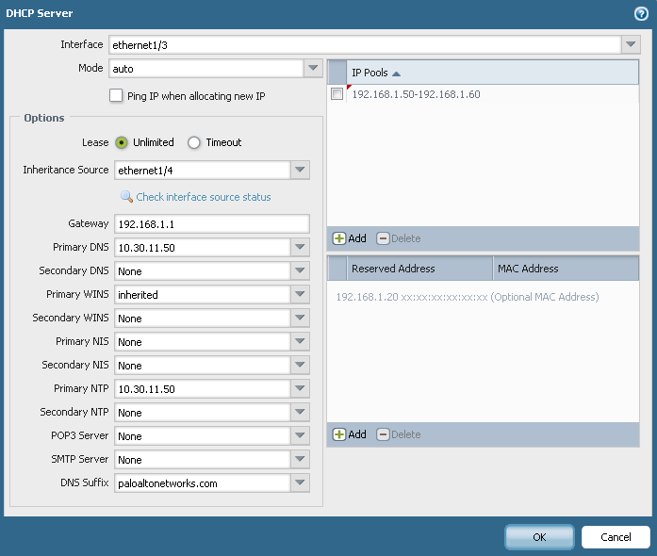
DHCP Server
Network > DHCP > DHCP Server

Slide 28
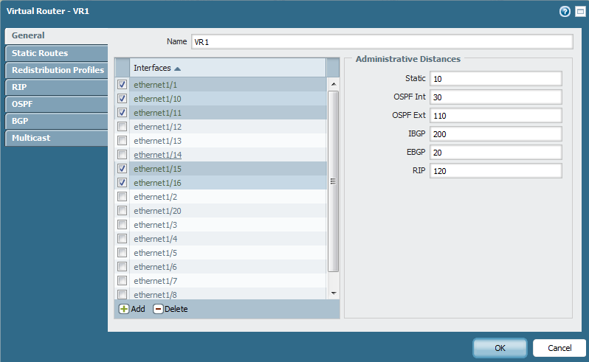
Virtual Routers
Network > Virtual Routers

Slide 29
Virtual Routers
Virtual routers enable the firewall to route packets at Layer 3 by making packet forwarding decisions according to the destination IP address (IPv4 or IPv6).
Each Layer 3 interface and VLAN interface defined on the firewall should be associated with a virtual router.
When you add an interface, its connected networks automatically are added to the virtual router’s route table and can be used by the virtual router to forward traffic.

Slide 30
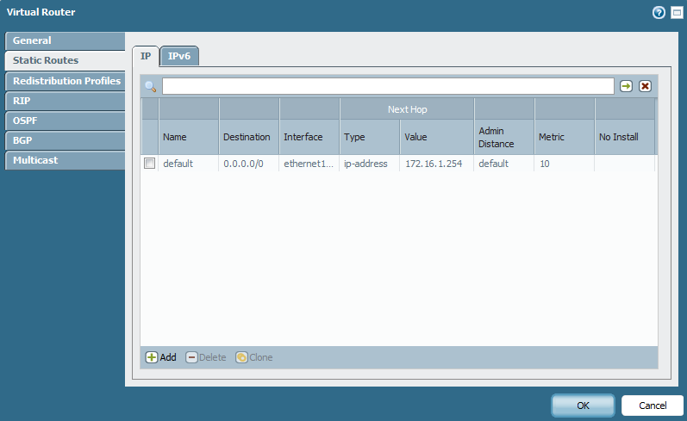
Virtual Router Static Routes
Network > Virtual Routers
Notes:
The Ethernet interfaces and VLAN interfaces defined on the firewall receive and forward the Layer 3 traffic. The destination zone is derived from the outgoing interface based on the forwarding criteria, and policy rules are consulted to identify the security policies to be applied.
In addition to routing to other network devices, virtual routers can route to other virtual routers within the same firewall if a next hop is specified to point to another virtual router.

Slide 31
Summary
You have learnt about firewalls:
Firewall Deployment Options
Virtual Wire Interface
Layer 3 Interface
Security Zone
Interface Management Profile
DHCP
Virtual Router

